Slide 1


Slide 2


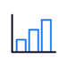

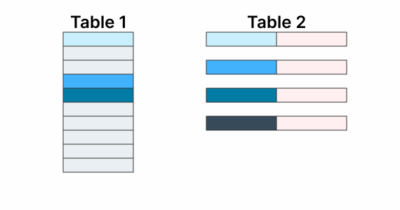

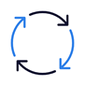










What is dbt?
dbt (data build tool) is a flexible data transformation tool that allows Data Scientists, Data Engineers and Analytics Engineers to quickly and easily model and transform data for analytics.
Data Sources
Data Reporting
Raw Data
Transformed Data
Data Loaders
Virtual Warehouses
Databases
L
BI Reporting
M
S
Applications
Data Science
Compile and Run
model.sql
model.sql
model.sql
Logging
Testing
Streaming
Alerting
Documentation
Ops Reporting
Deployment
Snapshots
Stakeholder
Data Engineer
Data Analyst
Exploratory Analysis
Flat files
Cleaning
Deduplication
Restructuring
Filtering
Joining
Aggregating

Slide 3
Unique Features
SQL - Anyone who can write SQL select statements can work with dbt.
Build Reusable and modular code with SQL + Jinja
Code in your favorite IDE which makes it:
Versionable
Testable
CI/CD workflow incorporation (spawn events and processes from code commits)
Built in logging and environment management
Comprehensive testing framework (schema and data tests)
Data model visualization and Documentation, autogenerated
Cross data platform (Snowflake, Big Query, Redshift, Presto, Spark, MS SQL Server*, etc)

Slide 4
A centralized environment for collaborative development
Develop
Test
Deploy
Document
IDE or CLI
Modular SQL
No DDL/DML
Pre-built packages
Schema tests
Data value testing
Pre-packaged tests for complex logic
Job scheduling
CI/CD
Version control
Logging & alerting
Dependency management
Auto-generate DAG
Auto-updated docs

Slide 5
A centralized environment for collaborative development
Develop faster with SELECT statements
Express business logic in SQL
Repeatable builds
Customizable materializations
Develop faster without having to think about run order
Run the same code in dev, test, and prod – the correct schema is resolved for you
Dependencies built automatically - you can focus on modeling, not run order
Develop
IDE or CLI
Modular SQL
No DDL/DML
Pre-built packages
IDE or CLI
Modular SQL
No DDL/DML
Pre-built packages
Runs in dev Warehouse as
orders.sql
create table analytics.dev.orders as (
select * from analytics.dev.stg_orders where is_deleted = false
);
select *
from {{ ref(‘stg_orders’) }} where is_deleted = false
Runs in prod Warehouse as
create table analytics.prod.orders as (
select * from analytics.prod.stg_orders where is_deleted = false
);

Slide 6
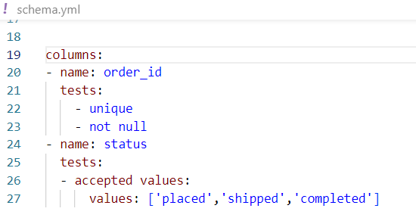
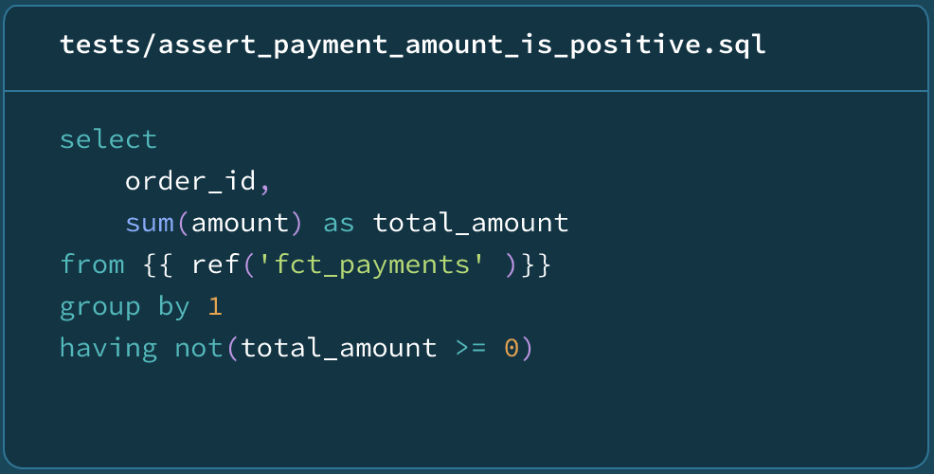
A centralized environment for collaborative development
Preserve quality by testing in-line
Test
Schema tests
Data value testing
Pre-packaged tests for complex logic
Test assumptions about data, and the validity of transformations
Custom out of the box tests
Learn about issues before stakeholders with fail/warn alerting

Slide 7
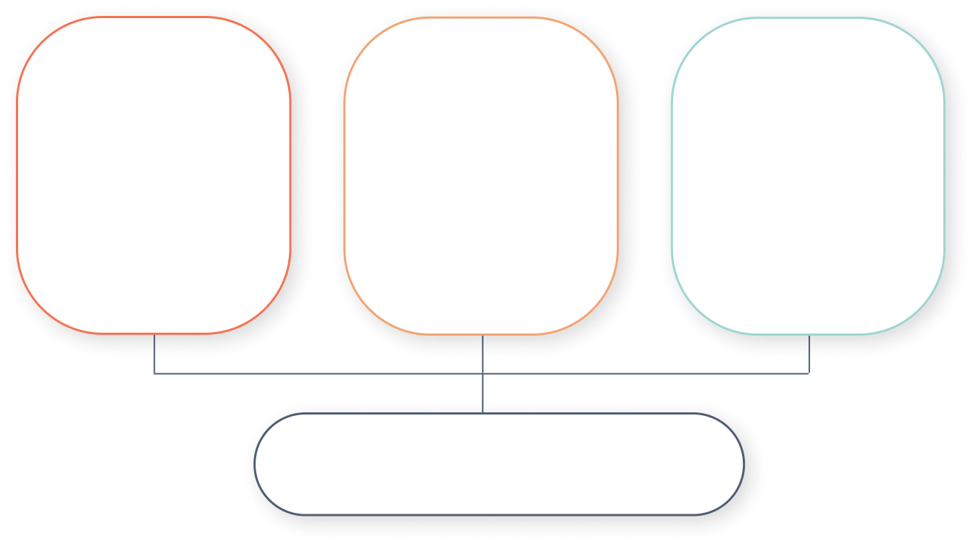
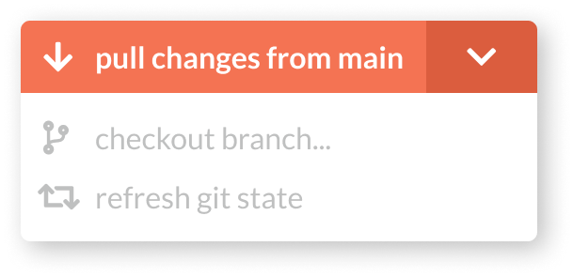
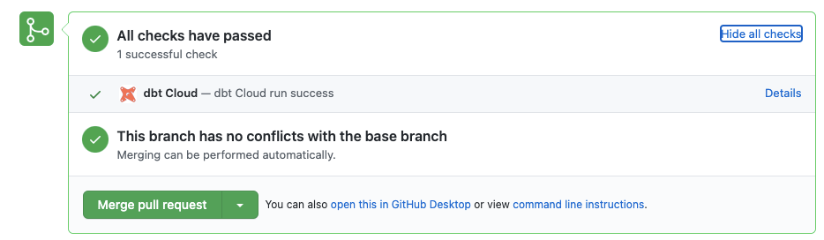
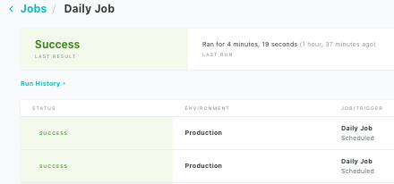
A centralized environment for collaborative development
Deploy seamlessly with version control and CI/CD
Deploy
Version Control
Continuous Integration
Continuous Deployment
Job scheduling
CI/CD
Version control
Logging & alerting
Job scheduling
CI/CD
Version control
Logging & alerting
Integrate with git provider of choice
Minimize wasteful runs by testing only changes
Job scheduling and alerting
Logging & Alerting

Slide 8
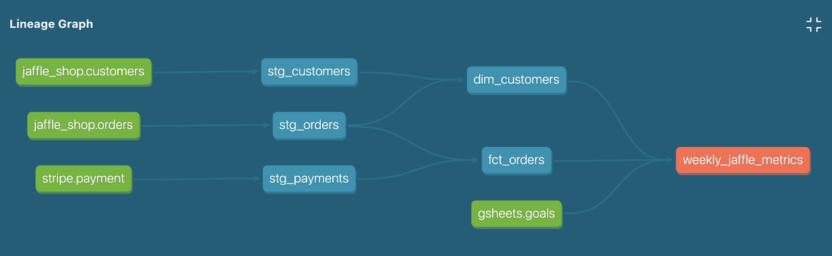
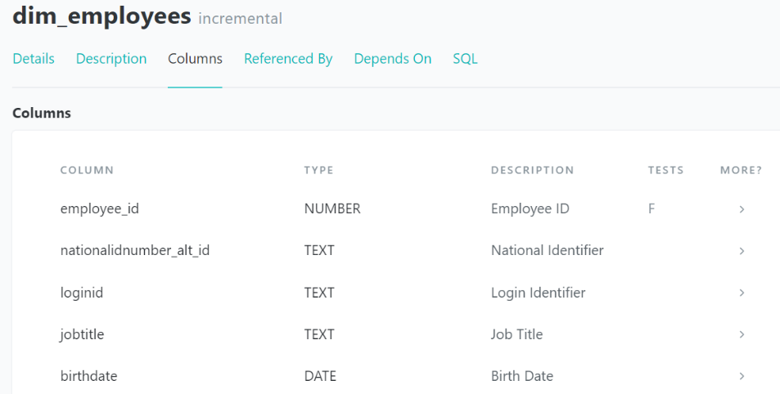
A centralized environment for collaborative development
dbt Docs: Single source of truth for data lineage
Fully self-documenting, including graph visualization and data dictionaries.
Document
Dependency management
Auto-generate DAG
Auto-updated docs

